Slide 1
Title: Customer Churn Prediction for TeleServe Subtitle: A Data-Driven Approach to Reducing Customer Attrition Presented By Felix Thomas 16th October 2024

Slide 2
ABOUT TeleServe
TeleServe is a leading global telecommunications company offering voice, data, and internet services.
TeleServe focuses on delivering innovative solutions to individual and corporate customers, with a strong commitment to customer retention as a key driver of business growth.
In the competitive telecom industry, retaining customers is critical to avoid revenue loss and market share decline.

Slide 3
PROBLEM OVERVIEW
TeleServe is facing a significant issue with customer churn, threatening its sustainability and growth. The current retention strategies are ineffective, causing loss of customers to competitors.
Stakeholders: Marketing, customer service, and product teams are impacted, with a goal to reduce churn by at least 5% within a year.
Objective: Develop a churn prediction model to identify at-risk customers early and enable targeted interventions.
This system aims to accurately forecast churn and implement targeted retention initiatives, helping TeleServe reduce attrition, enhance customer loyalty, and maintain a competitive edge in the telecommunications industry.

Slide 4
PROJECT FLOW DIAGRAM
Step 1: Business understanding (Goals and objectives)
Step 2: Data Collection from CRM (customer contracts, payments, demographics).
Step 3: Data Cleaning (handling missing values, outliers, duplicates).
Step 4: Exploratory Data Analysis (Insights into customer behaviors and patterns)
Step 5: Data preprocessing and Feature Selection (choosing relevant customer features).
Step 6: Model Training (training RandomForest and other algorithms).
Step 7: Model Evaluation and optimization
Step 8: Model Deployment (integrating into CRM for real-time churn prediction).
Business Understanding
Data Collection
Data Cleaning
EDA
Data preprocessing & feature selection
Model Deployment
Model Evaluation & Optimization
Model Training

Slide 5
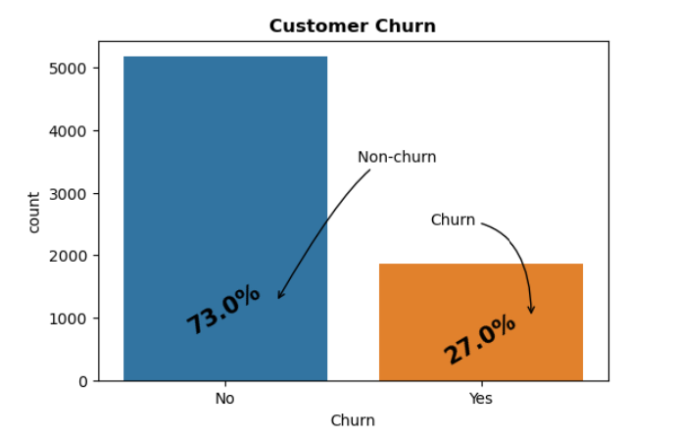
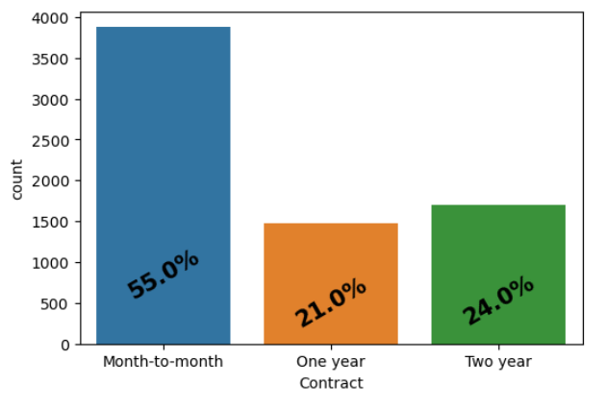
KEY INSIGHTS FROM DATA ANALYSIS
Churn Rate: 27% overall churn rate among customers.
Contract Type: 55% of customers are on month-to-month contracts, which have a significantly higher churn rate

Slide 6
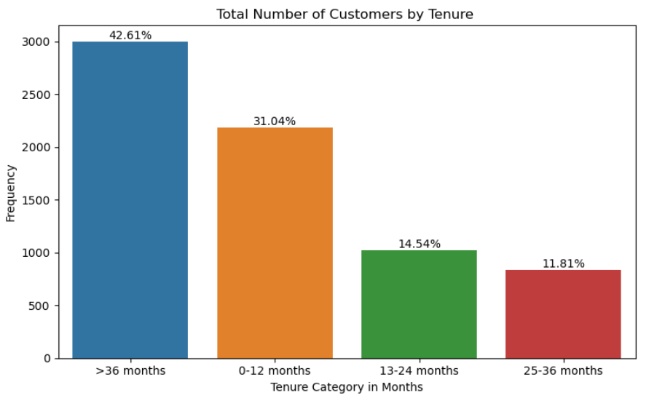
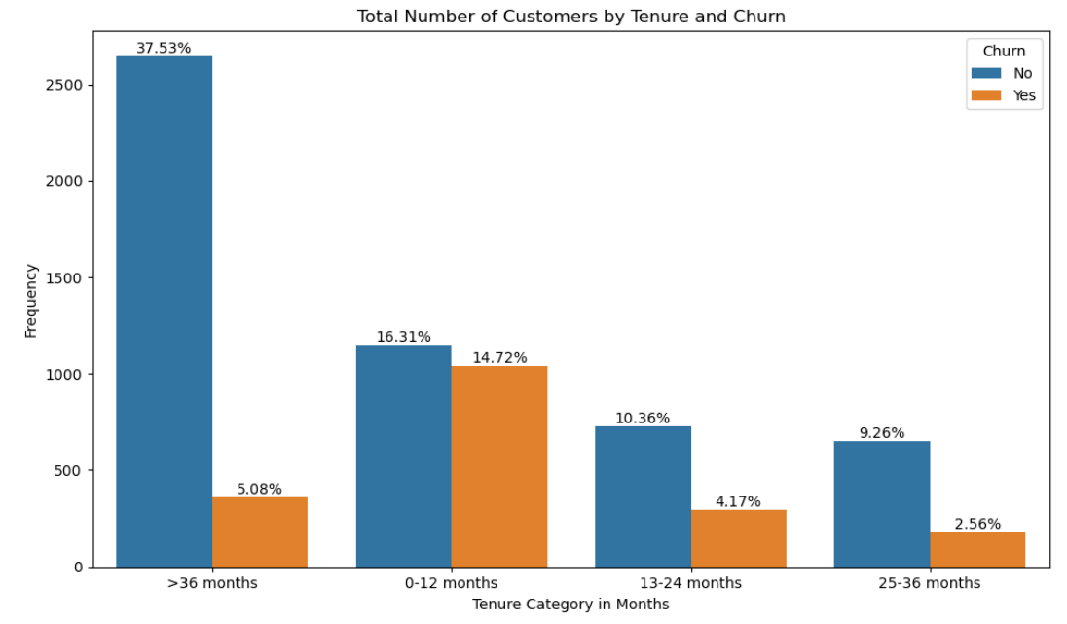
Approximately 43% of customers have a tenure exceeding 36 months, indicating a strong sense of loyalty based on their extended duration with the company.
Customer Tenure: Churn is highest (14.72%) among customers in their first 12 months and lowest for customers with 36+ months tenure

Slide 7
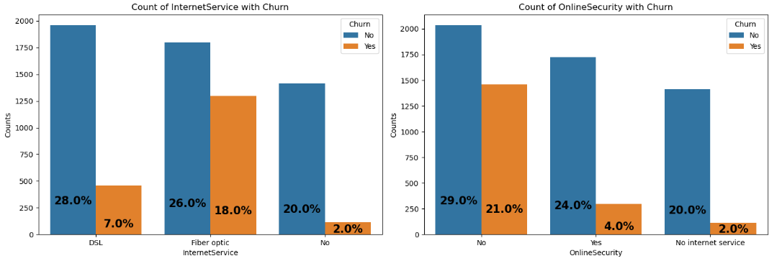
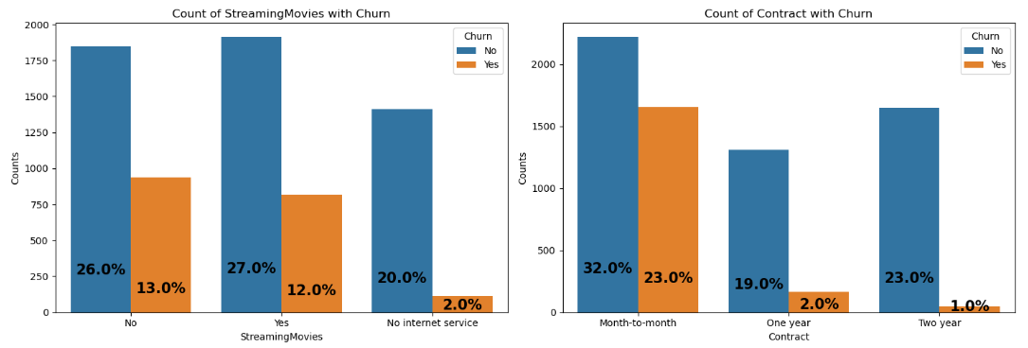
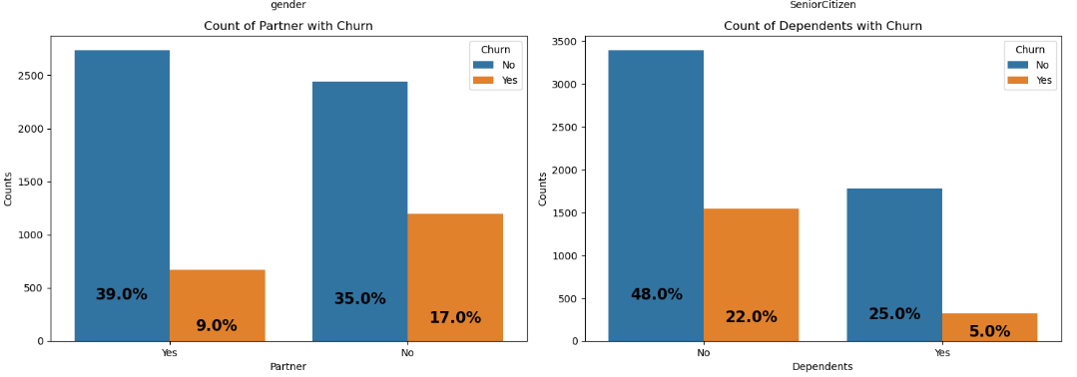
Service Type: Customers using fiber optic internet have an 18% churn rate, compared to 7% for DSL users.
Contract type: Customers on Month-to-month contract have high churn rate of 23%
Customer Demographics: Customers without a partner or dependents are more likely to churn.

Slide 8
INSIGHT SUMMARY
Tenure Impact: Customers with shorter tenure are more likely to churn, especially in the early months.
High Charges Risk: Customers with high Total Charges and Monthly Charges are at a higher risk of leaving.
Senior Citizens: They churn less frequently but still require personalized service to stay engaged.
Service Usage: Low usage of optional services (e.g., Streaming Movies, Phone Service) shows minimal impact on churn.
Gender Impact: Gender has a low influence on churn, but targeted marketing can still drive engagement.
Contract Type: Customers with longer contracts (e.g., annual) churn less compared to those on month-to-month plans.
Tech Support & Security: Customers with Tech Support and Online Security services tend to have lower churn rates.

Slide 9
DATA PREPROCESSING
Data Cleaning: Handling missing values (e.g., filling in missing data or removing incomplete rows), removing or fixing outliers that could skew the analysis.
Data Transformation: Standardizing or scaling numerical variables (like Monthly Charges, Total Charges) to ensure all features are on the same scale.
Encoding categorical variables (e.g., converting gender, internet service types into numerical form, such as using dummy variables).
Feature Engineering: Creating new features like tenure categories or interaction terms that help improve model accuracy.
Handling Class Imbalance: In churn vs. non-churn customers, I used techniques like oversampling to balance the dataset.
Splitting the Data: Dividing the data into training and testing sets (80/20 split).

Slide 10
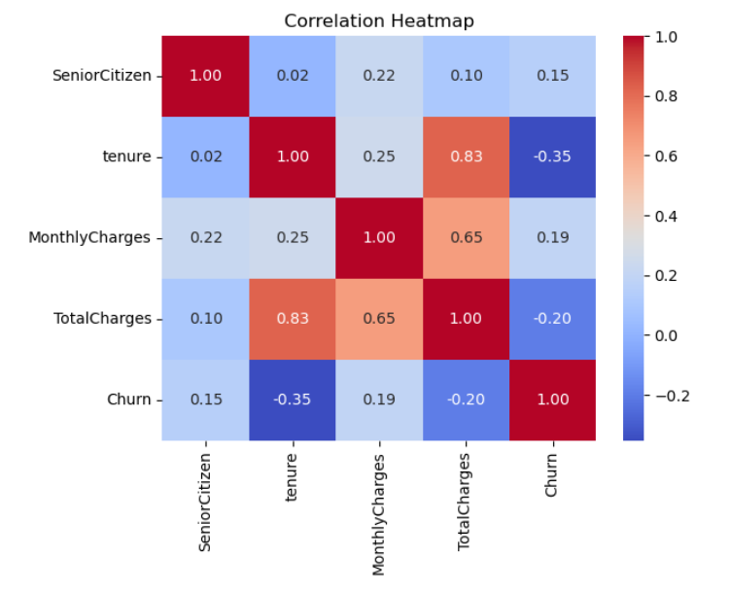
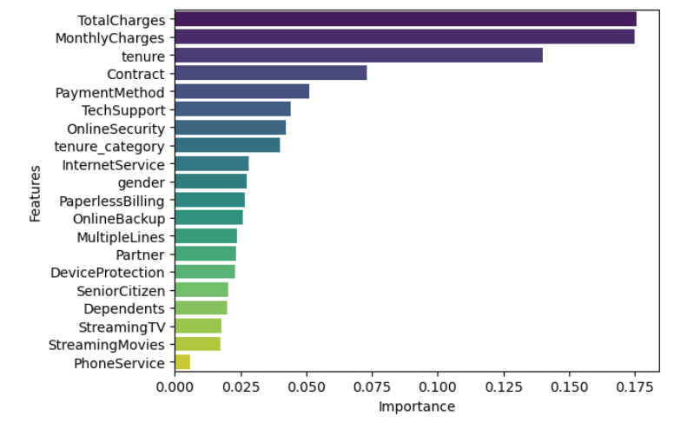
FEATURES SELECTION
Correlation Heatmap: Shows relationships between features.
Red areas: Strong positive
Blue areas: Negative correlation
Feature Importance Chart: Highlights key factors affecting churn.
Top features: Total Charges, Monthly Charges, and tenure have the biggest impact on predicting churn. Less important features like Phone Service have minimal influence.
These visuals guide us in focusing on the most relevant data for accurate churn prediction.

Slide 11
Machine Learning Algorithm Used (Results)
Model | Accuracy (%) | AUC-ROC (Class 1) | Precision (Class 1) | Recall (Class 1) | F1-Score (Class 1)
Logistic Regression | 81.69 | 0.8593 | 0.68 | 0.58 | 0.63
AdaBoost | 80.91 | 0.8580 | 0.68 | 0.54 | 0.60
RandomForest | 80.34 | 0.8578 | 0.67 | 0.50 | 0.58
SVC | 80.62 | 0.8088 | 0.68 | 0.50 | 0.58
XGBoost | 79.13 | 0.8365 | 0.63 | 0.51 | 0.57
Decision Tree | 71.97 | 0.6456 | 0.47 | 0.49 | 0.48
Several machine learning algorithms was used to predict customer churn:
RandomForest Classifier
Decision Tree Algorithm
Logistic Regression
Adaboost
XG Boost
SVC
Logistic Regression is the best-performing model for class 1, with the highest recall and a well-balanced F1-score. Other models, like AdaBoost and Random Forest, are competitive but fall short in identifying true positives, especially in terms of recall. The Decision Tree model is the least effective for class 1 detection.

Slide 12
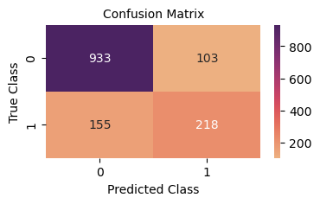
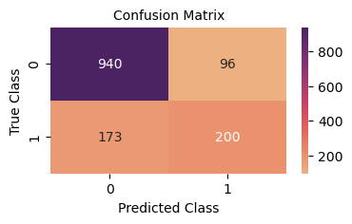
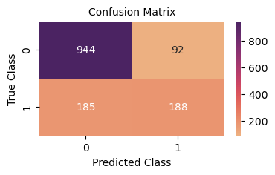
MODEL EVALUATION
Logistic Regression Adaboost RandomForest
The dataset contains 7043 records and split it 80/20 into training and testing sets. The confusion matrices displayed above are based on the test set, representing the evaluation of the models.
Training sets = 5634
Test sets = 1409
Note: class 0 = Not-churn (stay)
class 1 = churn (At-Risk)

Slide 13

BUSINESS IMPACT
High Accuracy: An 81.7% accurate model allows TeleServe to focus resources on the right customers, minimizing wasted efforts.
Retention Focus: The precision of the model ensures that marketing and customer support teams can target customers who are at the highest risk of leaving.
Potential Cost Savings: With this model, TeleServe could reduce churn by 5%, translating into potential savings of $1.5 million per year.
Campaign Optimization: The model enables more personalized retention campaigns, improving the efficiency of customer outreach.

Slide 14
Recommendations and Next Steps
Tenure-Based Offers: Provide discounts or rewards to customers with shorter tenure to reduce churn risk.
Service Personalization: Offer lower-cost service plans to customers with high Monthly Charges and promote service bundles like Streaming Movies to add value.
Demographic-Based Outreach: Tailor support and offers for senior citizens and gender-specific marketing where relevant.
Real-Time CRM Alerts: Integrate churn predictions into the CRM for personalized, timely retention efforts.
Add New Features: In future iterations, include loyalty program and customer feedback data to refine churn predictions.
Continuous Model Updates: Monitor and improve the model regularly to maintain high accuracy and recall rates.
What I Would Do Differently:
Explore deeper customer behavior data like frequency of service usage, loyalty program enrollment, and customer satisfaction surveys to better understand the underlying reasons for churn and refine the model further.

Slide 15
Thank you for listening.

